Slide 1

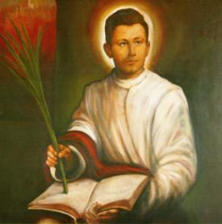
Miroslav Bulešić
- svjedok vjere
BISKUPIJA
POREČKA I PULSKA
B l a ž e n i
Uzor vjere u Hrvata
••••••••••••••••••••••••••••••••••

Slide 2

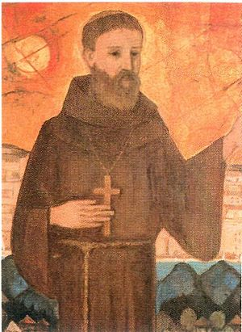
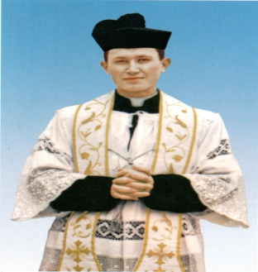
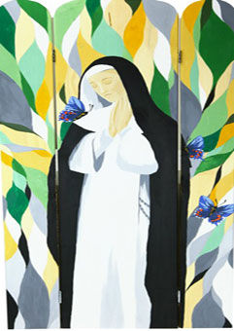

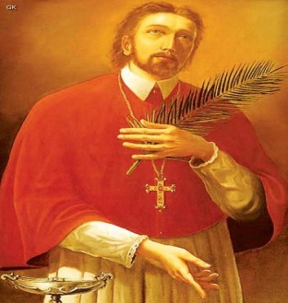
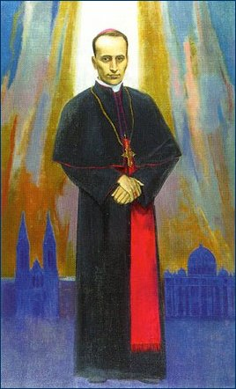
PRONAĐI PAROVE | A | B | C | D
1
2
3
Notes:
zadnja ok

Slide 3





Sadržaj
I. NA PUTU DO SVEĆENIŠTVA
II. ZAUZETA SVEĆENIČKA DJELATNOST
III. SVJEDOK VJERE
IV. BEATIFIKACIJA

Slide 4

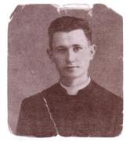
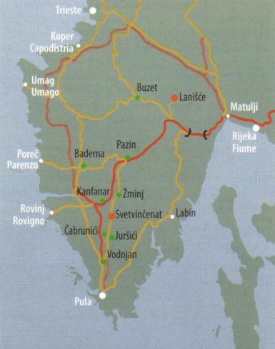
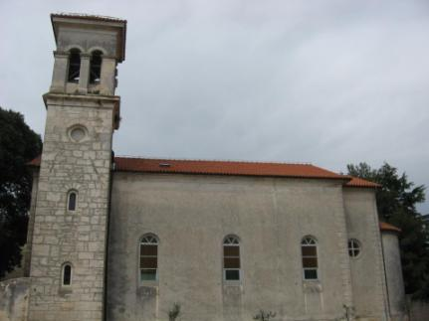
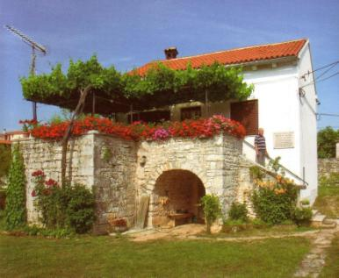
I. NA PUTU DO SVEĆENIŠTVA
rođen:
13. svibnja 1920.
⇨ Čabrunići
roditelji:
Miho i Lucija
kršten:
23. svibnja 1920.

Slide 5


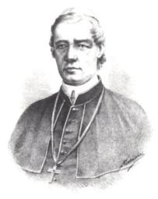
U duhu biskupa Dobrile
prve molitve i prve istine katoličke vjere naučio iz Dobrilina molitvenika «Oče budi volja tvoja»
osnovnu školu polazio u Juršićima vjeroučitelj ⇨ svećenik Ivan Pavić
1928. primio sv. krizmu
sa devet godina osjetio poziv u svećeništvo

Slide 6

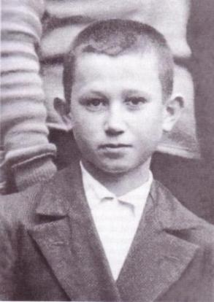
Sjemenište u Kopru
Šk. god. 1931./32. – 1939. – boravi u koparskom sjemeništu
završio pet razreda gimnazije i tri razreda liceja
1936. – kao 16-godišnji sjemeništarac službeno obukao kleričko odijelo - talar
... Bog moj si Ti: u rukama Tvojim sudbina je moja...
(Ps 30,15)

Slide 7

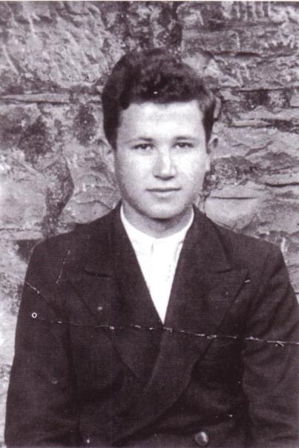
Poglavari u Kopru cijenili su Mira kao uzor sjemeništaraca:
“Gledajte onog Bulešića, kako se lijepo ponaša!”

Slide 8
U Vječnom gradu
1939. - polaže ispit zrelosti, veliku maturu
Jesen 1939. – na preporuku svećenika Ivana Pavića
porečko-pulski biskup Pederzolli upućuje ga na studij u Rim
“Radi se o odličnom mladiću, inteligentnom, otvorenom,
pobožnom i dobrom.”
Svećenik Ivan Pavić

Slide 9
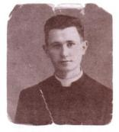
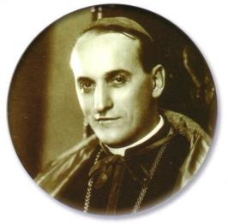
Studije u Rimu
u početku bio smješten u Francuskom zavodu koji je tada primao i studente nefrancuze
1940. – zagrebački nadbiskup Alojzije Stepinac pružio Bulešiću materijalnu pomoć za troškove smještaja

Slide 10
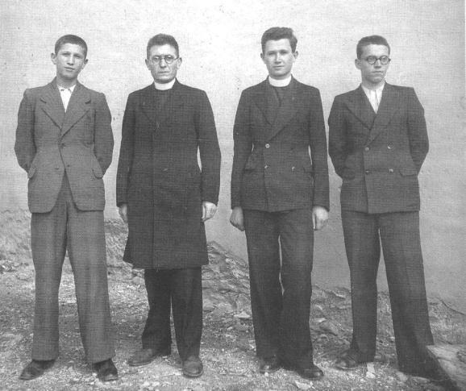
Jesen 1940.
s lijeva
Vlatko Lakoseljac,
Ivan Pavić,
Miroslav Bulešić i Antun Prodan

Slide 11
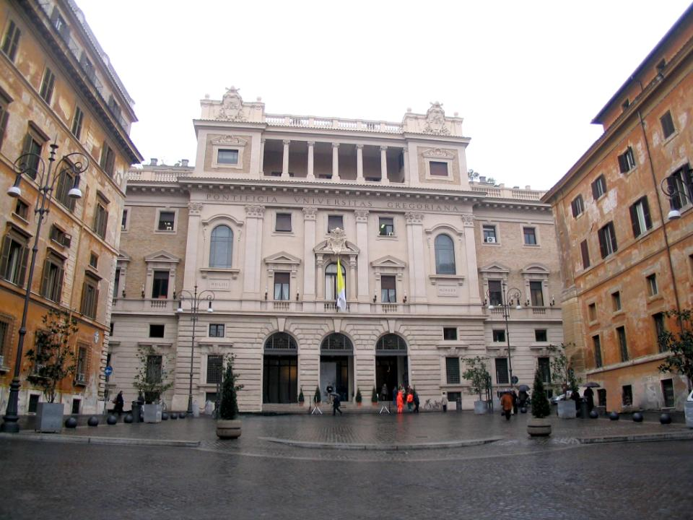
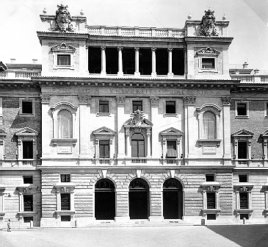
Bogoslovski studij u Rimu
Akad. god. 1939./40. – postiže licencijat iz filozofije na Filozofskom fakultetu papinskog sveučilišta Gregorijana
1943. – položio potrebne ispite iz teologije i postigao naslov «baccalaureus in theologia» s vrlo dobrim uspjehom

Slide 12

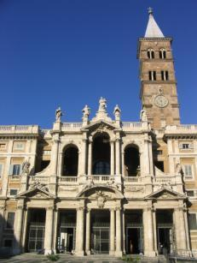
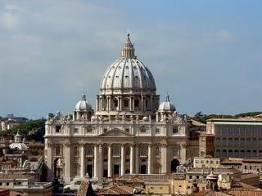
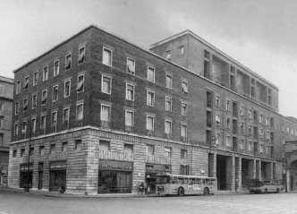
četiri godine bogoslovskog studija u središtu kršćanstva
bogata duhovna formacija

Slide 13
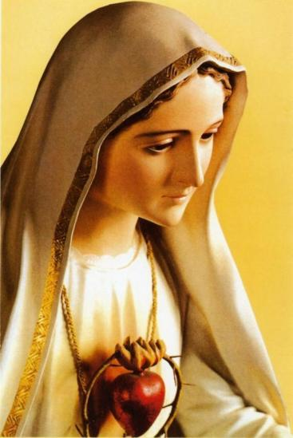
Posveta Blaženoj Djevici Mariji
u svim svojim poteškoćama i kušnjama mladi se bogoslov utječe Blaženoj Djevici Mariji
8. prosinca 1942. – obavio je osobnu posvetu
Majci Božjoj

Slide 14
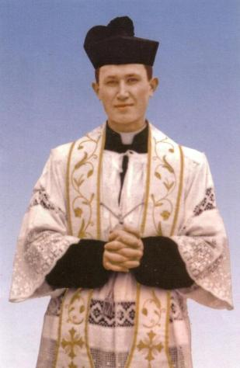
Mladomisnik
11. travnja 1943. – primio svećeničko ređenje u župnoj crkvi Navještenja Marijina u Svetvinčentu
(biskup msg. Raffaele Radossi)
“DOĐI KRALJEVSTVO TVOJE
BUDI VOLJA TVOJA”

Slide 15
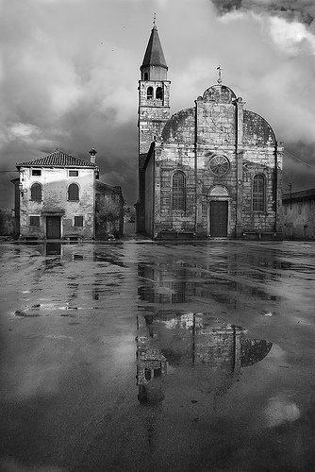
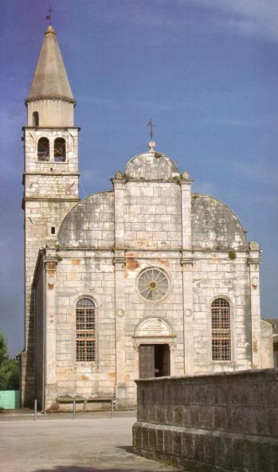
Mlada misa
26. travnja 1943.
– na Vazmeni ponedjeljak slavi Mladu misu u Svetvinčentu
Bulešić ostaje u Istri (kapitulacija Italije, Istra proglasila priključenje Hrvatskoj)

Slide 16

II. ZAUZETA SVEĆENIČKA DJELATNOST
Biciklom obilazi sela i zaselke
Zna pristupiti svakome i pomoći riječju, djelom i primjerom
“Između žalosng, tužnog, krvlju natopljenog naroda, mi moramo biti dobri Samaritanci, koji tješimo, liječimo, uzdižemo, zavijamo svaku ranu.”
Župnik u Baderni:
jesen 1943. – 1945.
Istra – poprište krvavih sukoba
uložio sve svoje snage u župski pastoralni rad
Nesebično pomaže potrebite

Slide 17

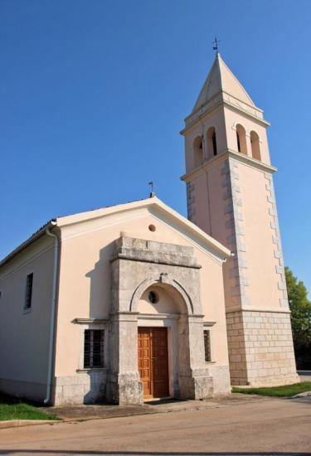
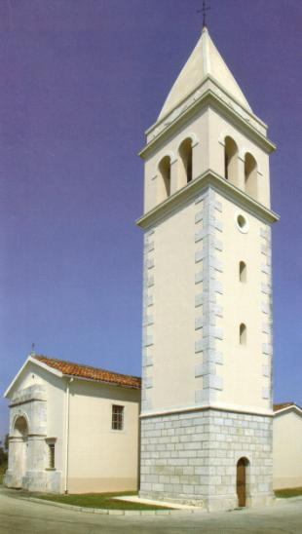
Župnik u Baderni
Bulešića krasila djelotvorna ljubav prema bližnjemu
Duhovno i vremenito dobro njegovih župljana bila mu je stalna briga
Dobra djela koja je činio bližnjima vlasti su mu izokretale i prikazivale ih kao zlo
Vremenite vrijednosti svećeniku Bulešiću nikada nisu zamijenile vječne vrednote

Slide 18
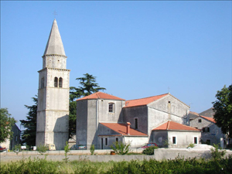
Župnik u Kanfanaru
Jesen 1945.

Slide 19

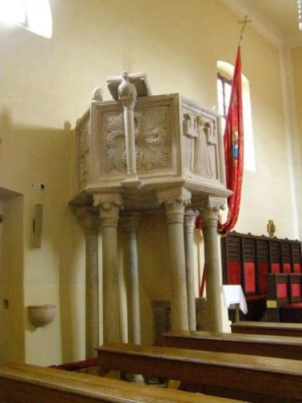
Svjetionik u župi Kanfanar
Posvećuje se duhovnoj obnovi župe
Oživljava pobožnosti
Uvodi crkveno pjevanje na hrvatskom jeziku
Organizira pučke misije
Odlučno nastupa s propovjedaonice župne crkve

Slide 20

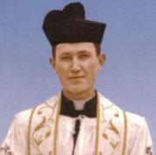
“Ako me ubiju, ubit će me za Boga i za vjeru”
Unatoč prijetnjama puk je hrlio u crkvu slušati hrabrog župnika
Bulešića su doživljavali kao zaštitnika svojih vjerskih prava i sloboda pred naletom agresivnog bezboštva
“U Italiji ima dosta svećenika, ovdje treba ostati.”

Slide 21
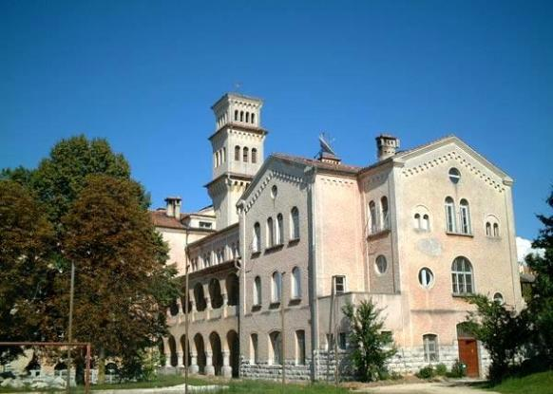
Poglavar u sjemeništu
Rujan, 1946.
Zgrada Biskupskog sjemeništa u Pazinu
Danas:
Pazinski kolegij- klasična gimnazija

Slide 22

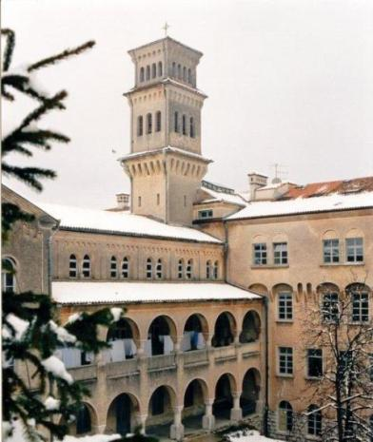
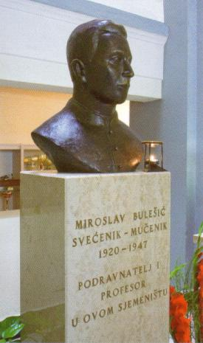
Poglavar u sjemeništu
U rujnu 1946. Bulešić prelazi na rad u Pazinsko sjemenište, gdje je imenovan podranateljem i profesorom
Sjemenište je otvorio tršćansko-koparski biskup Santin 1945.

Slide 23

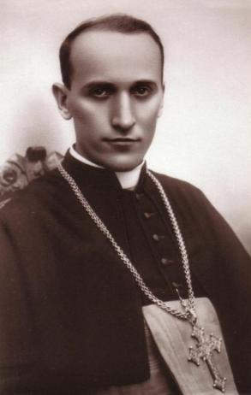
U audijenciji kod Stepinca
Prije početka šk. god. 1946./1947. skupina istarskih bogoslova i svećenika, posjetila Zagreb i nadbiskupa Alojzija Stepinca
Bulešić zahvalio Stepincu na novčanoj pomoći koju mu je slao u Rim za vrijeme studija

Slide 24
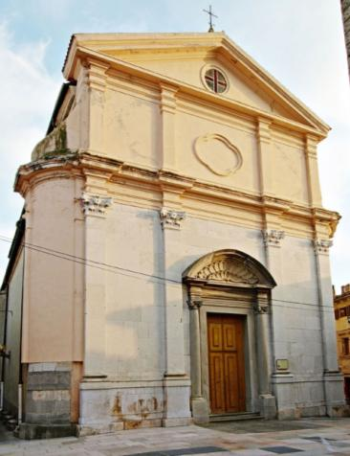
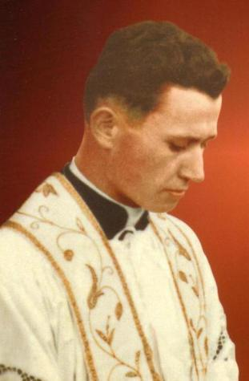
III. SVJEDOK VJERE
U lipnju 1947. otvoreno se usprotivio daljnjem popuštanju komunistima u vezi s “petogodišnjim planom”
U Tinjanu je spriječena krizma, a 23.8.1947. u Buzetu su provokatori izazivajući nerede u crkvi omeli podjeljivanje sv. krizme
“Ovuda možete proći samo preko mene mrtvoga.”

Slide 25
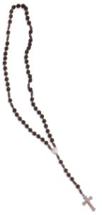
Krizma u Lanišću
Isuse, primi duh moj!
Nedjelja, 24. kolovoza 1947.
(blagdan sv. Bartola)
Sv. misa s krizmom započela sat ranije
Na vratima crkve stajali odvažniji Lanišćani
Krizmano oko 230 djece
Miroslav Bulešić ubijen nožem u župnoj kući
(oko 11 sati)

Slide 26
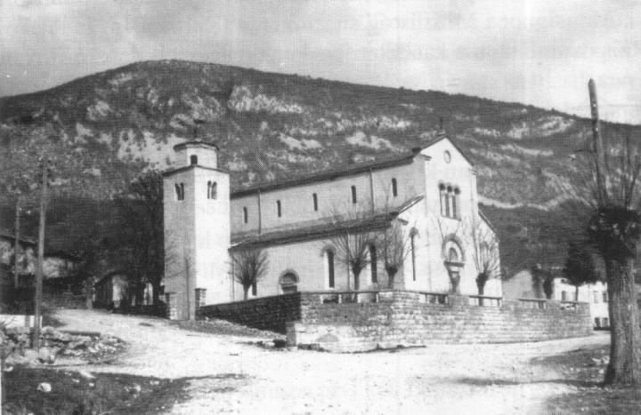
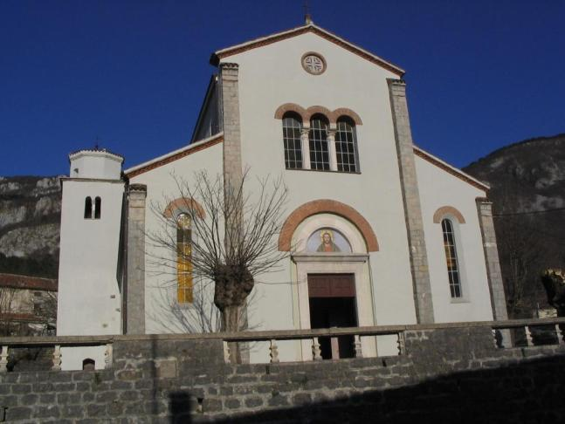
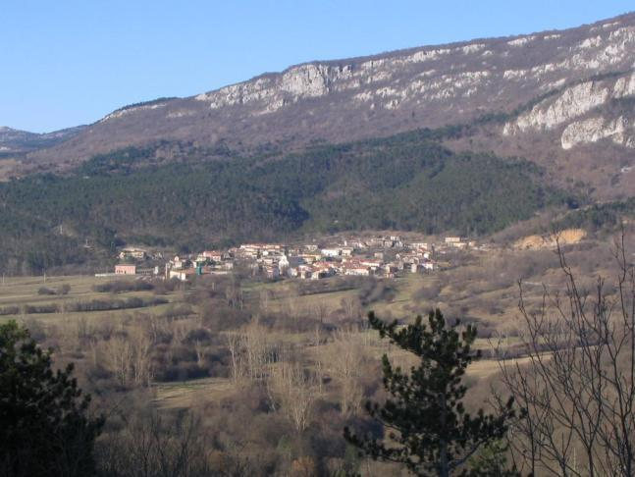
Lanišće

Slide 27
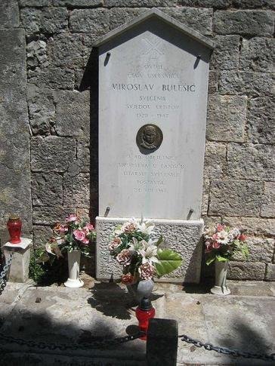
Pogreb mučenika u Lanišću
26. kolovoza
Predvodio dr. Ivan Pavić
Umjesto uobičajenih pogrebnih pjesama pjevalo se:
“Hoćemo Boga”,
“Krist pobjeđuje”...

Slide 28
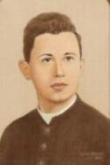
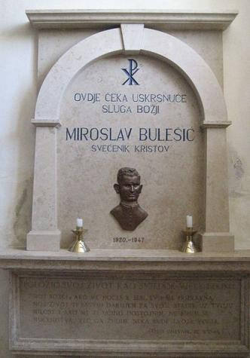
IV. BEATIFIKACIJA
Posmrtni ostatci preneseni 1958. u grobnicu ispred crkve na groblju u Svetvinčentu, a 2003. u župnu crkvu Marijina Navještenja.
Postupak za njegovu beatifikaciju pokrenut je najprije u tajnosti 1957., a objelodanjen je 1992.

Slide 29

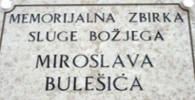
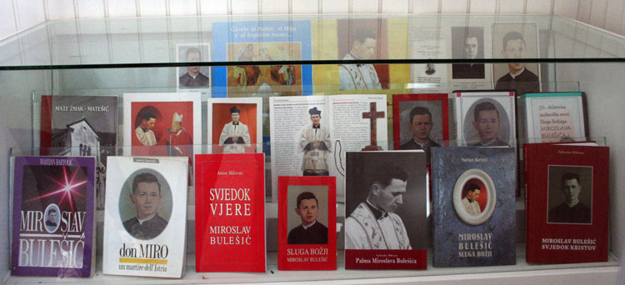
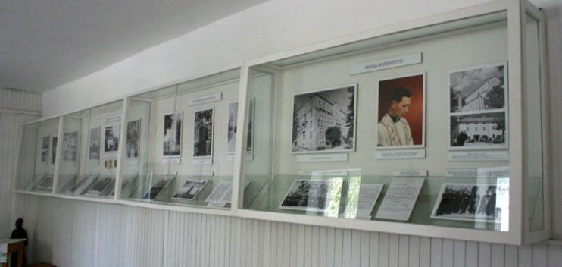
U Svetvinčentu 1997.
svečano obilježena 50. obljetnica smrti i postavljena Memorijalna zbirka sluge Božjega Miroslava Bulešića.

Slide 30

Biskupijski postupak je zaključen
2004. godine
20. prosinca 2012. Sveti Otac Benedikt XVI. ovlastio Kongregaciju da proglasi dekret o mučeništvu sluge Božjega Miroslava Bulešića
12. veljače 2013. g. Sveti Otac dopustio da se obred proglašenja blaženim Sluge Božjega Miroslava Bulešića obavi u Porečkoj i Pulskoj biskupiji u subotu, 28. rujna 2013. godine.

Slide 31
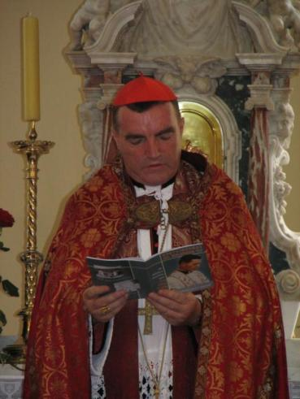
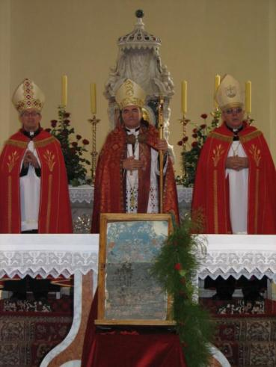
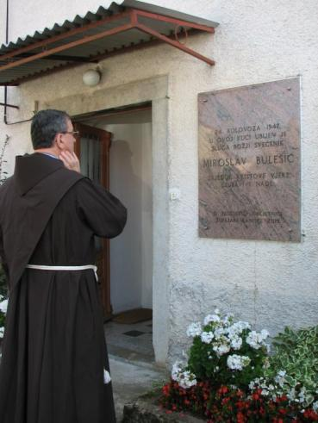
2007. – 60. obljetnica

Slide 32

Proslava u Lanišću

Slide 33
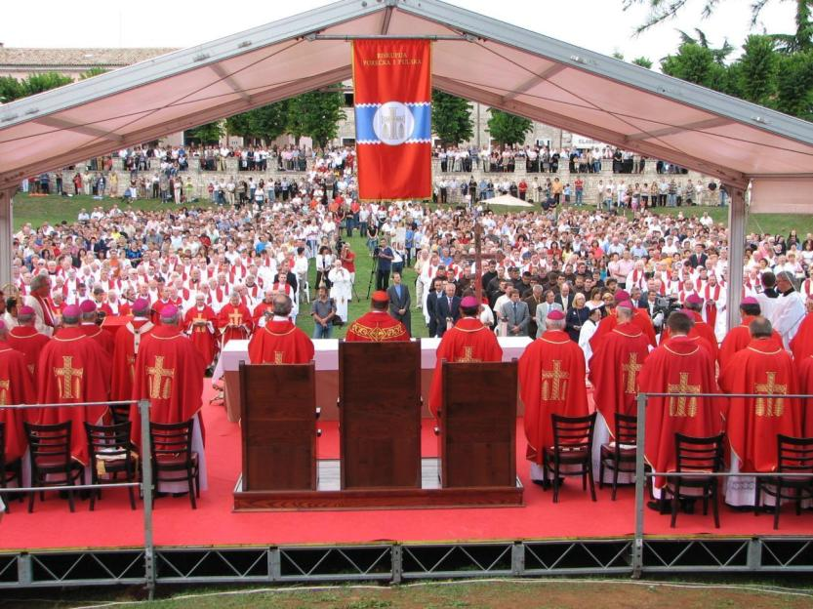


PRVO SVEĆENIČKO HODOČAŠĆE U ISTRU

Slide 34



Slide 35


Slide 36






“Kratak je vijek živio, a ispunio mnoga vremena”
Dosljedan u svom poslanju
Duboko uvjeren u ispravnost svojih stavova
U njegovom životu nije bilo mjesta za mržnju
Spreman podnijeti i poniženje i trpljenje za istinu

Slide 37



Blaženi Miroslave, zagovaraj nas!
Dobar, blag
društven,
inteligentan,
samokritičan,
čovjek molitve,
ponizan,
dobrotvor...
Iznimne ljubavi prema Crkvi,
angažirani pastoralac...
Svjestan svog poziva,
požrtvovan,
rodoljub,
oduševljen za Boga...

Slide 38
Bog moj si Ti: u rukama Tvojim sudbina je moja (Ps 30,15)
Dođi Kraljevstvo Tvoje. Budi volja Tvoja!
Želim umijeti samo za slavu Božju i spasenje duše svoje i duša mojih vjernika.
Isuse primi dušu moju!

Slide 39


sVJEDOČANSTVA
“Sa velikom boli saznao sam nakon svog dolaska iz tamnice, da je ubijen vlč. g. Bulešić, taj dobri i idealni mladi svećenik. To umorstvo neće donijeti blagoslova ubojicama niti onima po čijim su direktivama izvršili to gadno umorstvo. Žao mi je veoma da je jedan radnik manje na njivi Gospodnjoj u dragoj Istri.”
(A. Stepinac)
”Vi ste više dobili smrću toga mladog svećenika, nego li ste izgubili, jer ste dobili sveca i mučenika.”
(Joseph Harley)

Slide 40
Literatura
Marijan Bartolić, Miroslav Bulešić – Sluga Božji: svećenik-mučenik (1920.-1947.)
Antun Milovan, Svjedok vjere: Miroslav Bulešić, Poreč, 2001.
Vjekoslav Milovan, Palma Miroslava Bulešića, “Josip Turčinović”, Pazin, 2002.
Mate Žmak – Matešić, Krvava krizma Lanišće 1947., “Josip Turčinović”, Pazin, 2007.

Slide 41






Slide 43


Slide 44


Slide 46



• Dokumentarni film o Sluzi Božjem snimljen 1992.•

Slide 47





Različite brošure o Sluzi Božjem • Propovijedi kardinala Kuharića i Bozanića •

Slide 48

Bl. MIROSLAV BULEŠIĆ – svjedok vjere
(ukratko)
rođen 13.5. 1920. u selu Čabrunići, župa Svetvinčenat
nakon OŠ u Juršićima prelazi na školovanje u sjemenište u Kopar
filozofiju i teologiju studira u Rimu
svećenik postaje 1943.
Bio je župnik u Baderni i Kanfanaru, a 1946. postaje podravnatelj i profesor u pazinskom sjemeništu.
Kao student i mladi svećenik isticao se intelektualnim i duhovnim kvalitetama te radinošću i hrabrošću u zauzimanju za vjernike.
24. kolovoza 1947. ubijen je u Lanišću od napadača nahuškanih protuvjerskom mržnjom
mučenik za vjeru
(13.5.) 1958. tijelo mu je s laniškog groblja preneseno u Svetvinčenat
Bulešićevi zemni ostaci danas se nalaze u župnoj crkvi u Svetvinčentu
proglašenje blaženim: 28. rujna 2013. (u pulskoj Areni)

Slide 49



Blaženom Miroslavu Bulešiću
Marija Peteh

Slide 50



Slide 51


Učenički rad: Diego Tomišić, 8.a

Slide 52

Bulešić
kao inspiracija
Eugen Varzić
umjetnicima

Slide 53


Ponovimo
Uzori vjere\Miroslav Bulešić - budući hrvatski blaženik - Mir i dobro 6.1.2013.mp4
(Pronađi u prilogu novinarske pogreške!)
Učenički rad: Marijana Tomišić, 5. r.

Slide 54

Hvala na pažnji!
Izradila: Nela Peteh, dipl. theol.
OŠ Vladimira Gortana, Žminj
Fotografije 60. obljetnice:
Gordana Krizman
Notes:
To reproduce the background effects on this slide, do the following:
On the Home tab, in the Slides group, click Layout, and then click Blank.
Right-click the slide and then click Format Background.
In the Format Background dialog box, click Fill in the left pane. In the Fill pane, select Picture or texture fill, and then under Insert from, click File.
In the Insert Picture dialog box, select a picture, and then click Insert.
On the Home tab, in the Drawing group, click Shapes, and then under Rectangles, click Rectangle (first option from the left). On the slide, drag to draw a rectangle.
Select the rectangle. Under Drawing Tools, on the Format tab, in the Size group, do the following:
In the Shape Height box, enter 7.5”.
In the Shape Width box, enter 10”.
On the Home tab, in the Drawing group, click the arrow next to Shape Outline, and then click No Outline.
On the Home tab, in the Drawing group, click the arrow next to Shape Fill, point to Gradient, and then click More Gradients.
In the Format Shape dialog box, click Fill in the left pane. In the Fill pane, select Gradient fill, and then do the following:
In the Type list, select Radial.
Click the button next to Direction, and then click From Center (third option from the left).
Under Gradient stops, click Add or Remove until two stops appear in the drop-down list.
Also under Gradient stops, customize the gradient stops that you added as follows:
Select Stop 1 from the list, and then do the following:
In the Stop position box, enter 0%.
Click the button next to Color, and then under Theme Colors click Black, Text 1, Lighter 5% (sixth row, second option from the left).
In the Transparency box, enter 40%.
Select Stop 2 from the list, and then do the following:
In the Stop position box, enter 100%.
Click the button next to Color, and then under Theme Colors click Black, Text 1, Lighter 5% (sixth row, second option from the left).
In the Transparency box, enter 10%.
Select the rectangle. On the Home tab, in the Drawing group, click Arrange, point to Align, and then do the following:
Click Align Middle.
Click Align Center.
To reproduce the shape effects on this slide, do the following:
On the Home tab, in the Drawing group, click Shapes, and then under Lines, click Freeform (11th option from the left).
On the slide, click points to trace an outline around a shape on the background picture (in the example above, one of the flower petals).
Right-click the freeform shape and click Edit Points. To make the freeform shape more similar to the shape on the picture, right-click a place to include another point, and click Add Points. Drag the new point to follow the contour of the shape on the picture. To outline rounded edges of the shape on the picture, right-click a straight line segment, and click Curved Segment.
Select the freeform shape. On the Home tab, in the bottom right corner of the Drawing group, click the Format Shape dialog box launcher. In the Format Shape dialog box, click Line Color in the left pane, and then in the Line Color pane, select No line.
Also in the Format Shape dialog box, click Fill in the left pane, and then in the Fill pane, select Slide background fill.
Repeat the process in steps 1-5 to create six full-color shapes on the slide (in the example above, six flower petals from the same flower).
To reproduce the animation effects on this slide, do the following:
On the Animations tab, in the Animations group, click Custom Animation.
On the slide, select the rectangle. In the Custom Animation task pane, do the following:
Click Add Effect, point to Entrance, and then click More Effects. In the Add Entrance Effect dialog box, under Subtle, click Fade, and then click OK.
Under Modify: Fade, in the Start list, select After Previous.
Under Modify: Fade, in the Speed list, select Medium.
On the Home tab, in the Editing group, click Select, and then click Selection Pane. In the Selection and Visibility pane, press and hold CTRL and select all of the freeform shapes.
In the Custom Animation task pane, do the following:
Click Add Effect, point to Emphasis, and then click More Effects. In the Add Emphasis Effect dialog box, under Basic, click Spin, and then click OK.
Press and hold CTRL and select all of the freeform spin effects.
Under Modify: Spin, in the Start list, select With Previous.
Under Modify: Spin, in the Speed list, select Medium.
Also in the Custom Animation task pane, do the following to edit each freeform shape spin effect:
Select the first freeform shape spin effect, and then do the following:
Under Modify: Spin, in the Start list, select After Previous.
Under Modify: Spin, in the Amount list, in the Custom box, enter 360⁰, and then press ENTER. Also in the Amount list, click Counterclockwise.
Select the second freeform shape spin effect, and then do the following:
Under Modify: Spin, in the Amount list, in the Custom box, enter 30⁰, and then press ENTER. Also in the Amount list, click Clockwise.
Right-click the freeform shape spin effect, and then click Timing. In the Spin dialog box, on the Timing tab, in the Delay box, enter 0.3.
Select the third freeform shape spin effect, and then do the following:
Under Modify: Spin, in the Amount list, in the Custom box, enter 40⁰, and then press ENTER. Also in the Amount list, click Clockwise.
Right-click the freeform shape spin effect, and then click Timing. In the Spin dialog box, on the Timing tab, in the Delay box, enter 0.3.
Select the fourth freeform shape spin effect, and then do the following:
Under Modify: Spin, in the Amount list, in the Custom box, enter 90⁰, and then press ENTER. Also in the Amount list, click Counterclockwise.
Right-click the freeform shape spin effect, and then click Timing. In the Spin dialog box, on the Timing tab, in the Delay box, enter 0.4.
Select the fifth freeform shape spin effect, and then do the following:
Under Modify: Spin, in the Amount list, in the Custom box, enter 90⁰, and then press ENTER. Also in the Amount list, click Clockwise.
Right-click the freeform shape spin effect, and then click Timing. In the Spin dialog box, on the Timing tab, in the Delay box, enter 0.5.
Select the sixth freeform shape spin effect, and then do the following:
Under Modify: Spin, in the Amount list, in the Custom box, enter 360⁰, and then press ENTER. Also in the Amount list, click Clockwise.
Right-click the freeform shape spin effect, and then click Timing. In the Spin dialog box, on the Timing tab, in the Delay box, enter 0.6.
In the Selection and Visibility pane, press and hold CTRL and select all of the freeform shapes. In the Custom Animation task pane, do the following:
Click Add Effect, point to Emphasis, and then click More Effects. In the Add Emphasis Effect dialog box, under Basic, click Grow/Shrink, and then click OK.
Press and hold CTRL and select all of the grow/shrink effects (the final six effects in the list).
Under Modify: Grow/Shrink, in the Start list, select With Previous.
Under Modify: Grow/Shrink, in the Speed list, select Medium.
Also in the Custom Animation task pane, do the following to edit each freeform shape grow/shrink effect:
Select the first freeform shape grow/shrink effect, and then do the following:
Under Modify: Grow/Shrink, in the Size list, in the Custom box, enter 40%, and then press ENTER. Also in the Size list, click Vertical.
In the pane, drag the effect until it is third in the list of effects.
Select the second freeform shape grow/shrink effect, and then do the following:
Under Modify: Grow/Shrink, in the Size list, in the Custom box, enter 50%, and then press ENTER. Also in the Size list, click Horizontal.
In the pane, drag the effect until it is fifth in the list of effects.
Select the third freeform shape grow/shrink effect, and then do the following:
Under Modify: Grow/Shrink, in the Size list, in the Custom box, enter 50%, and then press ENTER. Also in the Size list, click Horizontal.
In the pane, drag the effect until it is seventh in the list of effects.
Select the fourth freeform shape grow/shrink effect, and then do the following:
Under Modify: Grow/Shrink, in the Size list, in the Custom box, enter 40%, and then press ENTER. Also in the Size list, click Vertical.
In the pane, drag the effect until it is ninth in the list of effects.
Select the fifth freeform shape grow/shrink effect, and then do the following:
Under Modify: Grow/Shrink, in the Size list, in the Custom box, enter 50%, and then press ENTER. Also in the Size list, click Horizontal.
In the pane, drag the effect until it is 11th in the list of effects.
Select the sixth freeform shape grow/shrink effect, and then do the following:
Under Modify: Grow/Shrink, in the Size list, in the Custom box, enter 50%, and then press ENTER. Also in the Size list, click Horizontal.
In the pane, drag the effect until it is 13th in the list of effects.
In the Selection and Visibility pane, press and hold CTRL and select all of the freeform shapes. In the Custom Animation task pane, click Add effect, point to Motion Path, point to Draw Custom Motion Path, and then click Curve.
On the slide, click five points to create a simple curved motion path, starting on the group of freeform shapes and ending off the right side of the slide. Double-click the final point to accept the motion path.
In the Custom Animation task pane, do the following:
Press and hold CTRL and select all of the freeform shape custom path effects (the final six effects in the list).
Under Modify: Custom Path, in the Start list, select With Previous.
Under Modify: Custom Path, in the Speed list, select Medium.
Also in the Custom Animation task pane, do the following:
Drag the first custom path effect until it is fourth in the list of effects.
Drag the second custom path effect until it is seventh in the list of effects.
Drag the third custom path effect until it is 10th in the list of effects.
Drag the fourth custom path effect until it is 13th in the list of effects.
Drag the fifth custom path effect until it is 16th in the list of effects.
Drag the sixth custom path effect until it is 19th in the list of effects.

